Slide 1

Test Automation - Selenium
by
Girish Godbole

Slide 2
Test Automation
Why Automation is Important
Given the right tools, automating computer operations can be surprisingly easy and can reap major benefits. Understanding these benefits—and some obstacles—will help you develop support for an operations automation project. A recent study by a leading trade journal asked the question, “What do you see as the most important benefits of an automated or unattended computer center?” The primary benefits of operations automation cited most often were cost reduction, productivity, availability, reliability, and performance.
Reducing Operational Costs
Increasing Productivity
Ensuring High Availability
Increasing Reliability
Optimizing Performance
Time Saving
Enhance workflow efficiency

Slide 3
Automation
What is Automation Testing?
Automation Testing is a software testing technique that performs using special automated testing software tools to execute a test case suite. On the contrary, Manual Testing is performed by a human sitting in front of a computer carefully executing the test steps.
The automation testing software can also enter test data into the System Under Test, compare expected and actual results and generate detailed test reports. Software Test Automation demands considerable investments of money and resources.

Slide 4
Automation
Which Test Cases to Automate?
Test cases to be automated can be selected using the following criterion to increase the automation ROI
High Risk – Business Critical test cases
Test cases that are repeatedly executed
Test Cases that are very tedious or difficult to perform manually
Test Cases which are time-consuming
The following category of test cases are not suitable for automation:
Test Cases that are newly designed and not executed manually at least once
Test Cases for which the requirements are frequently changing
Test cases which are executed on an ad-hoc basis.

Slide 5
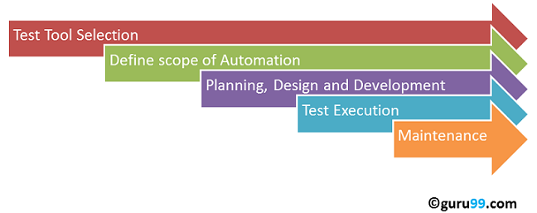
Automation
Automated Testing Process:
Following steps are followed in an Automation Process
Step 1) Test Tool Selection
Step 2) Define scope of Automation
Step 3) Planning, Design and Development
Step 4) Test Execution
Step 5) Maintenance

Slide 6
Automation
Test tool selection
Test Tool selection largely depends on the technology the Application Under Test is built on. For instance, QTP does not support Informatica. So QTP cannot be used for testing Informatica applications. It’s a good idea to conduct a Proof of Concept of Tool on AUT.
Define the scope of Automation
The scope of automation is the area of your Application Under Test which will be automated. Following points help determine scope:
The features that are important for the business
Scenarios which have a large amount of data
Common functionalities across applications
Technical feasibility
The extent to which business components are reused
The complexity of test cases
Ability to use the same test cases for cross-browser testing

Slide 7
Automation
Framework for Automation
A framework is set of automation guidelines which help in
Maintaining consistency of Testing
Improves test structuring
Minimum usage of code
Less Maintenance of code
Improve re-usability
Non Technical testers can be involved in code
The training period of using the tool can be reduced
Involves Data wherever appropriate
Automation Frameworks
Data Driven Automation Framework
Keyword Driven Automation Framework
Modular Automation Framework
Hybrid Automation Framework

Slide 8
Manual Vs Automation
Parameter | Automation Testing | Manual Testing
Definition | Automation Testing uses automation tools to execute test cases. | In manual testing, test cases are executed by a human tester and software.
Processing time | Automated testing is significantly faster than a manual approach. | Manual testing is time-consuming and takes up human resources.
Exploratory Testing | Automation does not allow random testing | Exploratory testing is possible in Manual Testing
Initial investment | The initial investment in the automated testing is higher. Though the ROI is better in the long run. | The initial investment in the Manual testing is comparatively lower. ROI is lower compared to Automation testing in the long run.
Reliability | Automated testing is a reliable method, as it is performed by tools and scripts. There is no testing Fatigue. | Manual testing is not as accurate because of the possibility of the human errors.
UI Change | For even a trivial change in the UI of the AUT, Automated Test Scripts need to be modified to work as expected | Small changes like change in id, class, etc. of a button wouldn’t thwart execution of a manual tester.
Investment | Investment is required for testing tools as well as automation engineers | Investment is needed for human resources.

Slide 9
Manual Vs Automation
Parameter | Automation Testing | Manual Testing
Cost-effective | Not cost effective for low volume regression | Not cost effective for high volume regression.
Test Report Visibility | With automation testing, all stakeholders can login into the automation system and check test execution results | Manual Tests are usually recorded in an Excel or Word, and test results are not readily/ readily available.
Human observation | Automated testing does not involve human consideration. So it can never give assurance of user-friendliness and positive experience. | The manual testing method allows human observation, which may be useful to offer user-friendly system.
Performance Testing | Performance Tests like Load Testing, Stress Testing, Spike Testing, etc. have to be tested by an automation tool compulsorily. | Performance Testing is not feasible manually
Parallel Execution | This testing can be executed on different operating platforms in parallel and reduce test execution time. | Manual tests can be executed in parallel but would need to increase your human resource which is expensive
Batch testing | You can Batch multiple Test Scripts for nightly execution. | Manual tests cannot be batched.
Programming knowledge | Programming knowledge is a must in automation testing. | No need for programming in Manual Testing.

Slide 10
Manual Vs Automation
Parameter | Automation Testing | Manual Testing
Set up | Automation test requires less complex test execution set up. | Manual testing needs have a more straightforward test execution setup
Engagement | Done by tools. Its accurate and never gets bored! | Repetitive Manual Test Execution can get boring and error-prone.
Ideal approach | Automation testing is useful when frequently executing the same set of test cases | Manual testing proves useful when the test case only needs to run once or twice.
Build Verification Testing | Automation testing is useful for Build Verification Testing (BVT). | Executing the Build Verification Testing (BVT) is very difficult and time-consuming in manual testing.
Deadlines | Automated Tests have zero risks of missing out a pre-decided test. | Manual Testing has a higher risk of missing out the pre-decided test deadline.
Framework | Automation testing uses frameworks like Data Drive, Keyword, Hybrid to accelerate the automation process. | Manual Testing does not use frameworks but may use guidelines, checklists, stringent processes to draft certain test cases.

Slide 11
Manual Vs Automation
Parameter | Automation Testing | Manual Testing
Documentation | Automated Tests acts as a document provides training value especially for automated unit test cases. A new developer can look into a unit test cases and understand the code base quickly. | Manual Test cases provide no training value
Test Design | Automated Unit Tests enforce/drive Test Driven Development Design. | Manual Unit Tests do not drive design into the coding process
Devops | Automated Tests help in Build Verification Testing and are an integral part of DevOps Cycle | Manual Testing defeats the automated build principle of DevOps
When to Use? | Automated Testing is suited for Regression Testing, Performance Testing, Load Testing or highly repeatable functional test cases. | Manual Testing is suitable for Exploratory, Usability and Adhoc Testing. It should also be used where the AUT changes frequently.

Slide 12
Manual Testing Pros and Cons
Pros of Manual Testing:
Get fast and accurate visual feedback
It is less expensive as you don’t need to spend your budget for the automation tools and process
Human judgment and intuition always benefit the manual element
While testing a small change, an automation test would require coding which could be time-consuming. While you could test manually on the fly.
Cons of Manual Testing:
Less reliable testing method because it’s conducted by a human. Therefore, it is always prone to mistakes & errors.
The manual testing process can’t be recorded, so it is not possible to reuse the manual test.
In this testing method, certain tasks are difficult to perform manually which may require an additional time of the software testing phase.

Slide 13
Automated Testing Pros and Cons
Pros of automated testing:
Automated testing helps you to find more bugs compare to a human tester
As most of the part of the testing process is automated, you can have a speedy and efficient process
Automation process can be recorded. This allows you to reuse and execute the same kind of testing operations
Automated testing is conducted using software tools, so it works without tiring and fatigue unlike humans in manual testing
It can easily increase productivity because it provides fast & accurate testing result
Automated testing support various applications
Testing coverage can be increased because of automation testing tool never forget to check even the smallest unit
Cons of Automated Testing:
Without human element, it’s difficult to get insight into visual aspects of your UI like colors, font, sizes, contrast or button sizes.
The tools to run automation testing can be expensive, which may increase the cost of the testing project.
Automation testing tool is not yet foolproof. Every automation tool has their limitations which reduces the scope of automation.
Debugging the test script is another major issue in the automated testing. Test maintenance is costly.

Slide 14
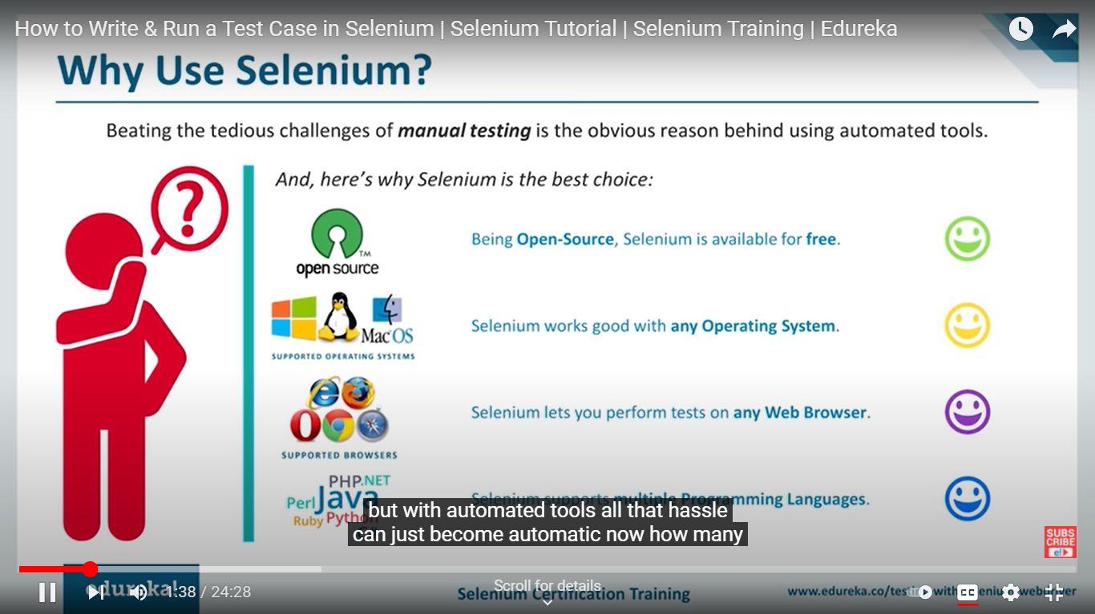

Slide 15
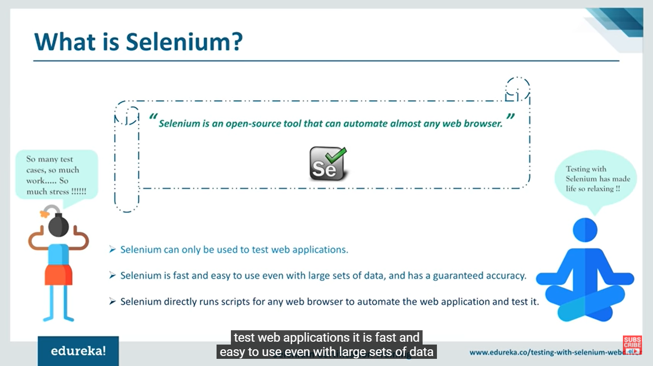

Slide 16
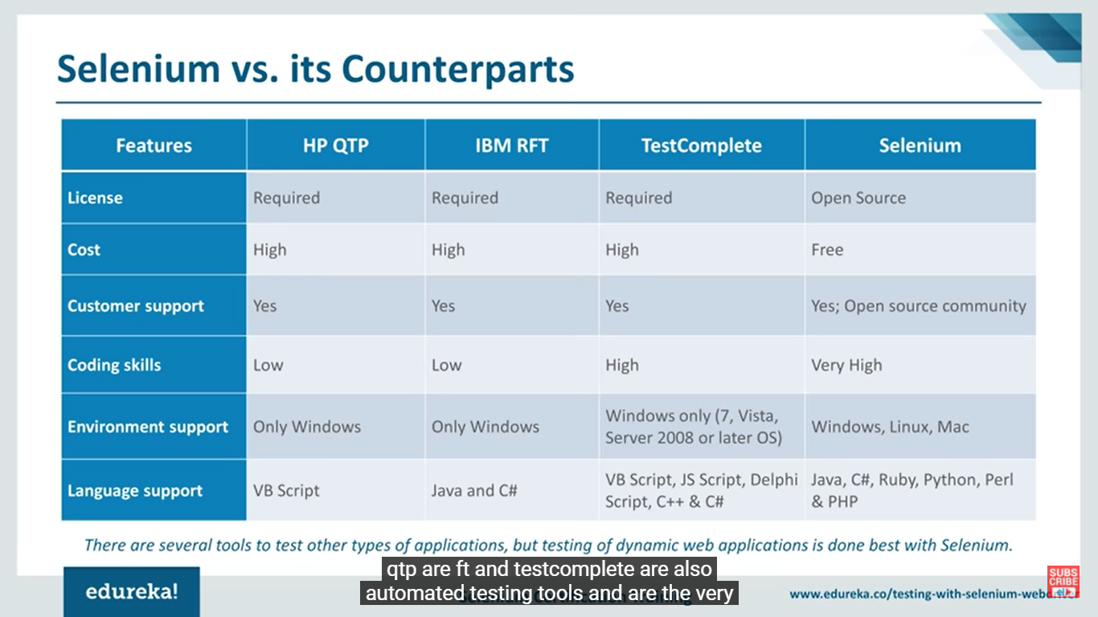

Slide 17
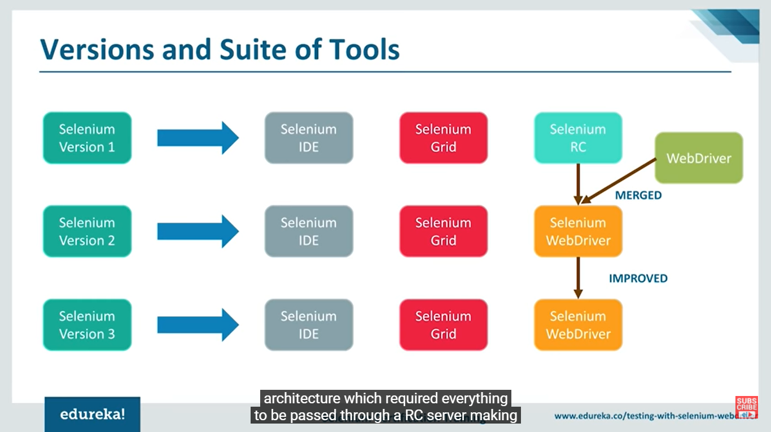

Slide 18


Slide 19
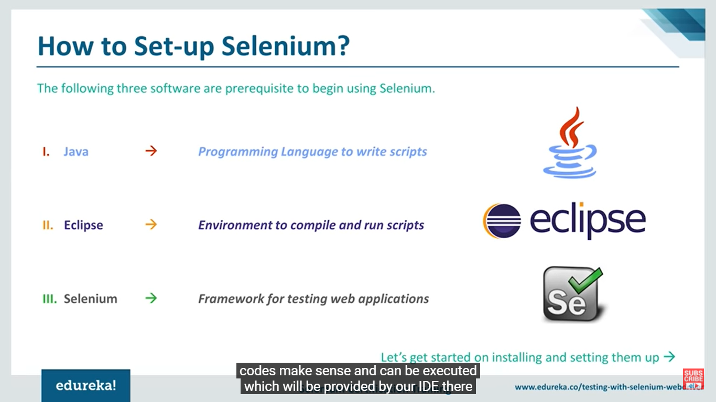

Slide 20
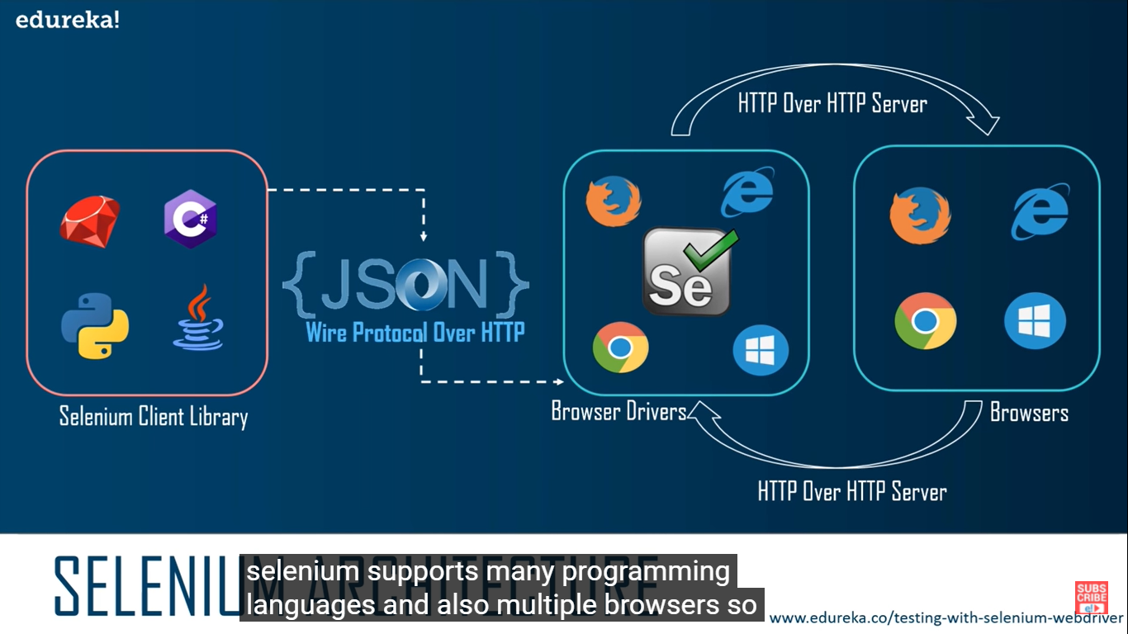
Selenium Architecture

Slide 21
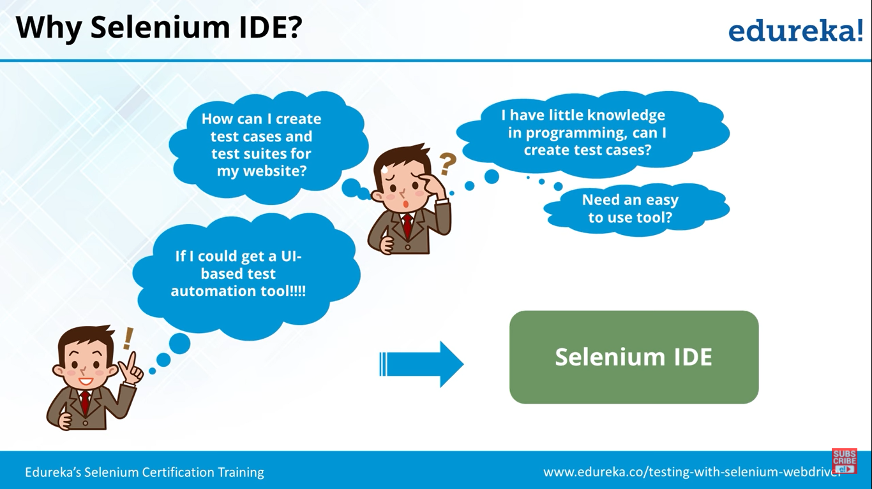
What is Selenium IDE

Slide 22
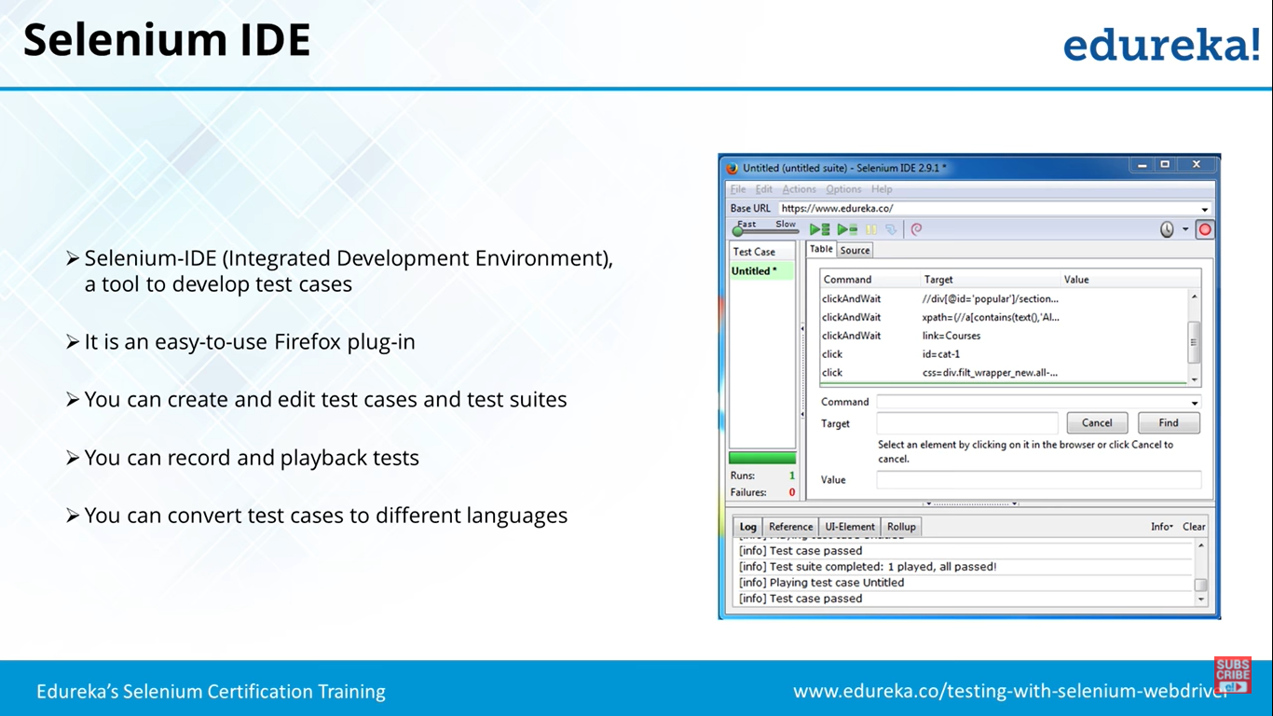
Selenium IDE

Slide 23
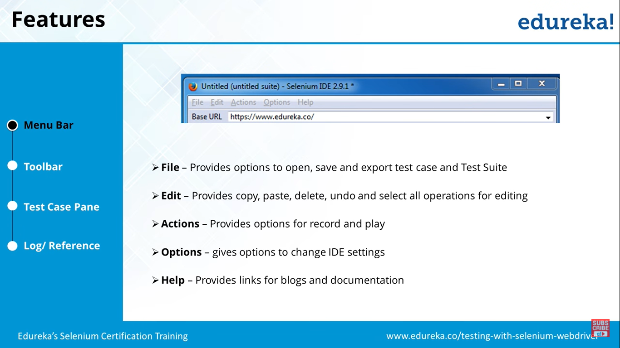
Selenium IDE - Features

Slide 24
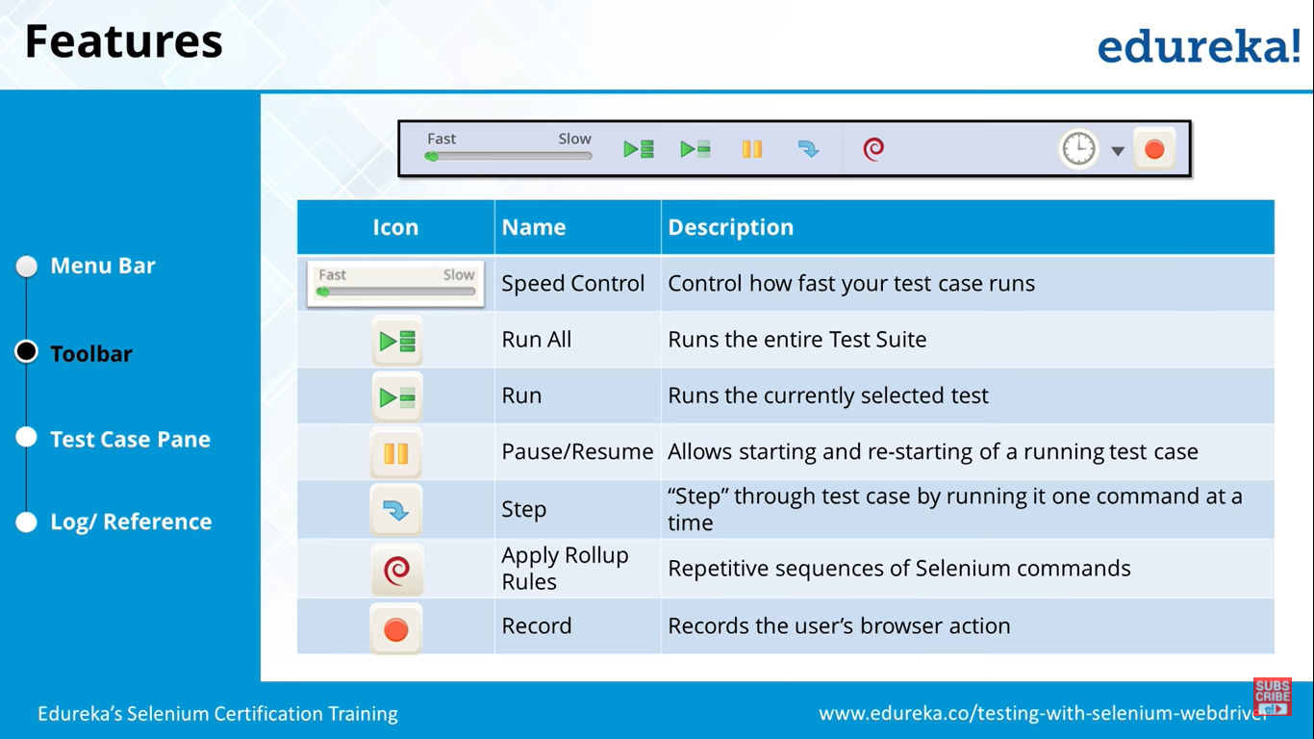
Selenium IDE - Features

Slide 25
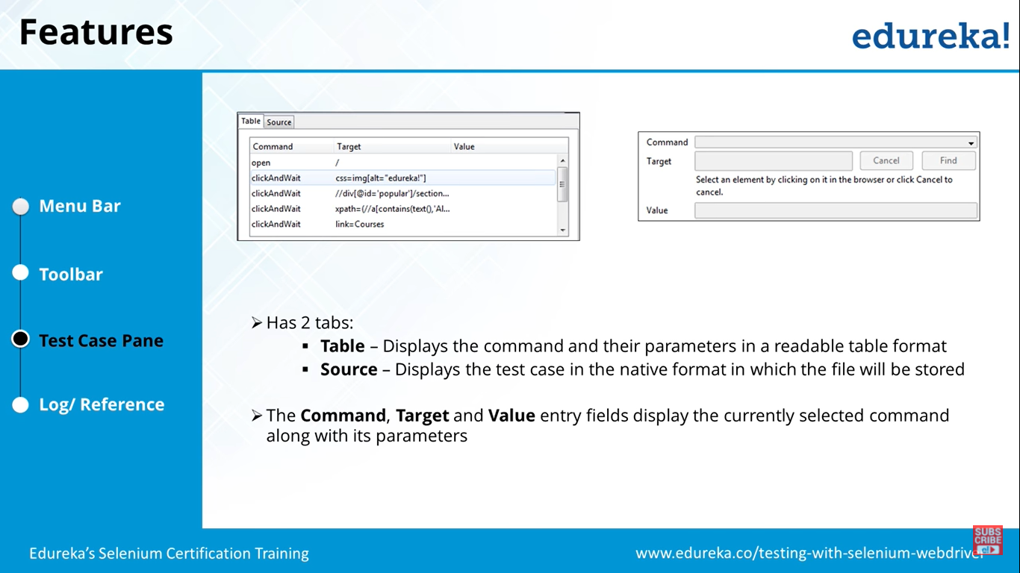
Selenium IDE - Features

Slide 26
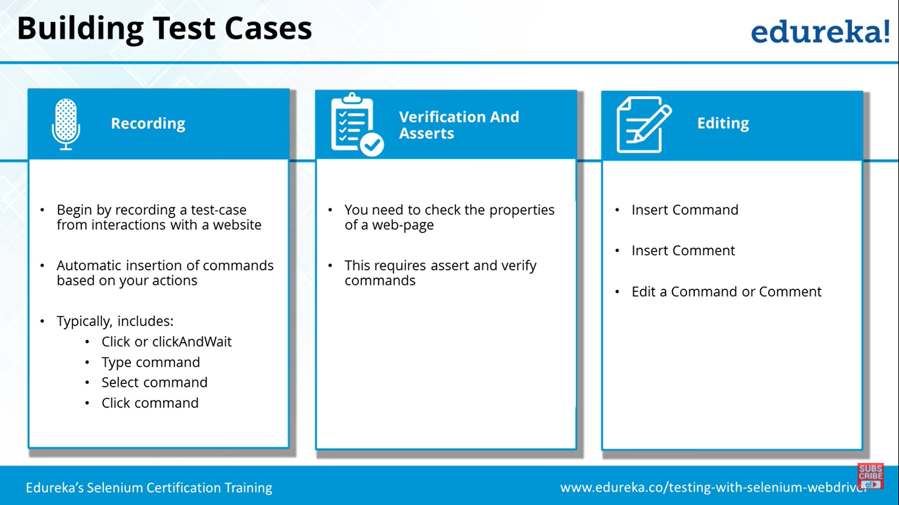
Building Test - IDE

Slide 27
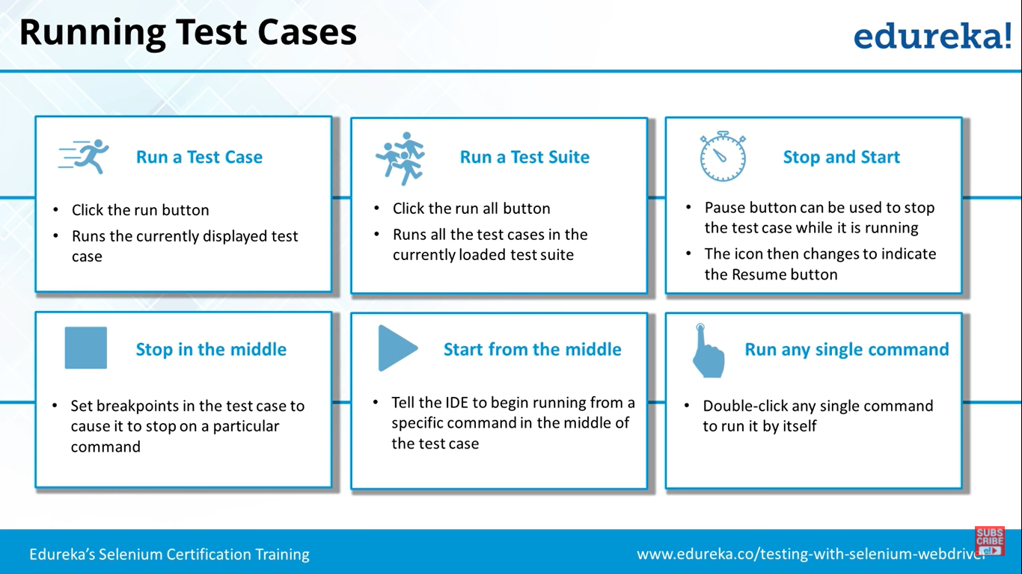
Running Test Cases - IDE

Slide 28
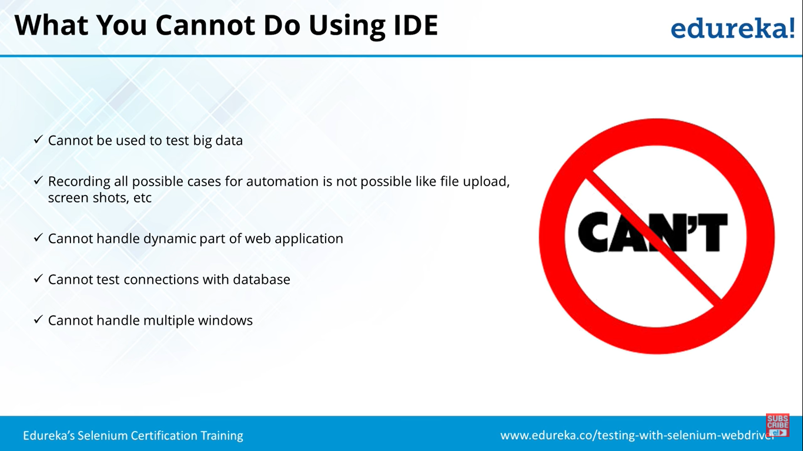
What you cant do using IDE

Slide 29
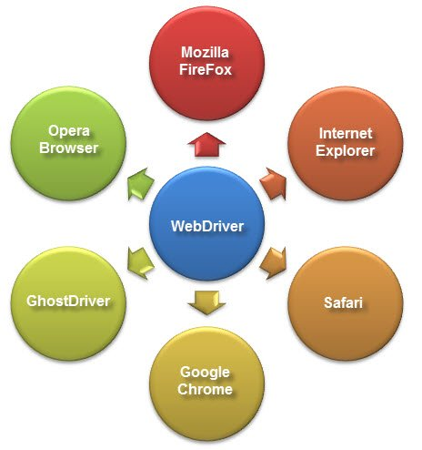
Selenium WebDriver
Selenium Webdriver is an open-source collection of APIs which is used for testing web applications. The Selenium Webdriver tool is used for automating web application testing to verify that it works as expected or not. It mainly supports browsers like Firefox, Chrome, Safari and Internet Explorer. It also permits you to execute cross-browser testing.
WebDriver also enables you to use a programming language in creating your test scripts (not possible in Selenium IDE).

Slide 30
Selenium WebDriver
WebDriver is a tool for testing web applications across different browsers using different programming languages.
You are now able to make powerful tests because WebDriver allows you to use a programming language of your choice in designing your tests.
WebDriver is faster than Selenium RC because of its simpler architecture.
WebDriver directly talks to the browser while Selenium RC needs the help of the RC Server in order to do so.
WebDriver’s API is more concise than Selenium RC’s.
WebDriver can support HtmlUnit while Selenium RC cannot.
The only drawbacks of WebDriver are:
It cannot readily support new browsers, but Selenium RC can.
It does not have a built-in command for automatic generation of test results.

Slide 31


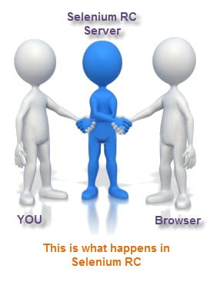

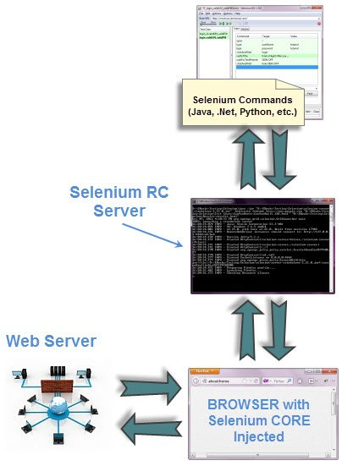
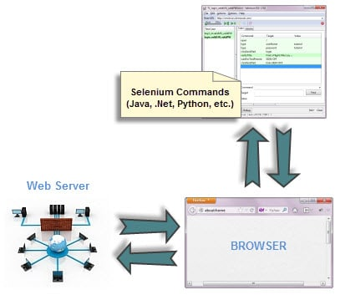
Selenium RC Vs WebDriver
WebDriver
RC – Remote Control

Slide 32
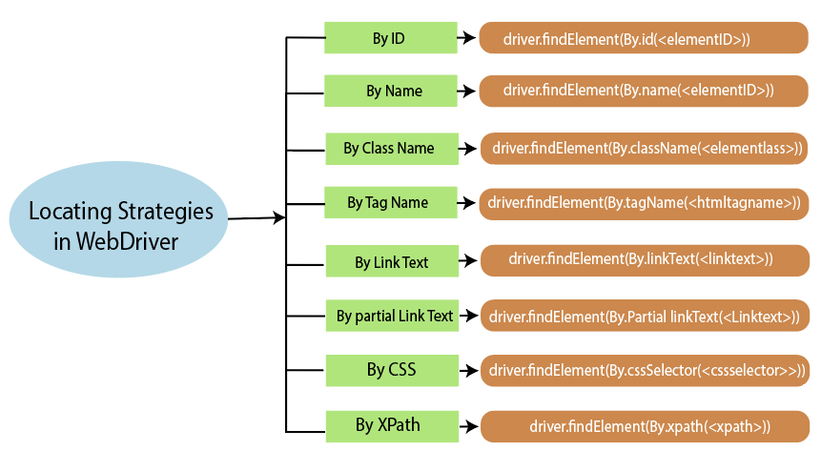
WebDriver Locators

Slide 33
IDE vs RC vs WebDriver
IDE | RC | WebDriver
It only works in Mozilla browser. | It supports with all browsers like Firefox, IE, Chrome, Safari, Opera etc. | It supports with all browsers like Firefox, IE, Chrome, Safari, Opera etc.
It supports Record and playback | It doesn’t supports Record and playback | It doesn’t supports Record and playback
Doesn’t required to start server before executing the test script. | Required to start server before executing the test script. | Doesn’t required to start server before executing the test script.
It is a GUI Plug-in | It is standalone java program which allow you to run Html test suites. | It actual core API which has binding in a range of languages.
Core engine is Javascript based | Core engine is JavaScript based | Interacts natively with browser application
Very simple to use as it is record & playback. | It is easy and small API | As compared to RC, it is bit complex and large API.
It is not object oriented | API’s are less Object oriented | API’s are entirely Object oriented
It doesn’t supports of moving mouse cursors. | It doesn’t supports of moving mouse cursors. | It supports of moving mouse cursors.
Need to append full xpath with ‘xpath=\\’ syntax | Need to append full xpath with ‘xpath=\\’ syntax | No need to append full xpath with ‘xpath=\\’ syntax
It does not supports listeners | It does not supports listeners | It supports the implementation of listeners
It does not support to test iphone/Android applications | It does not support to test iphone/Android applications | It support to test iphone/Android applications

Slide 34
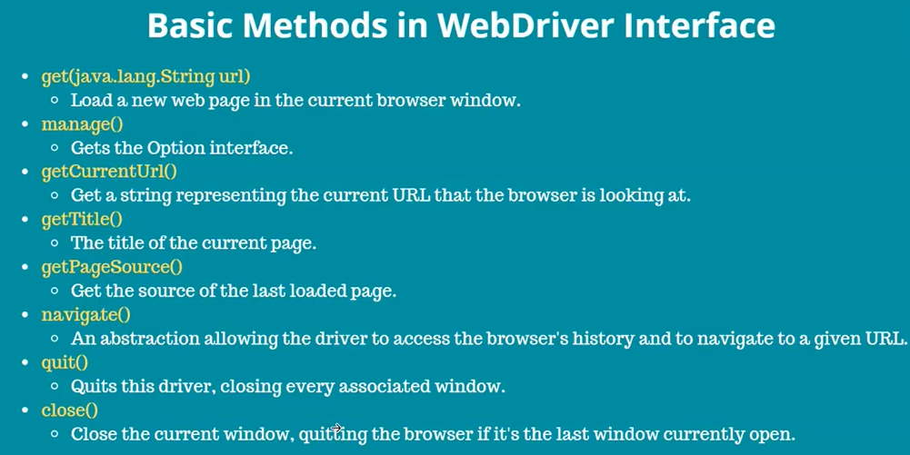
WebDriver Elements -Methods

Slide 35
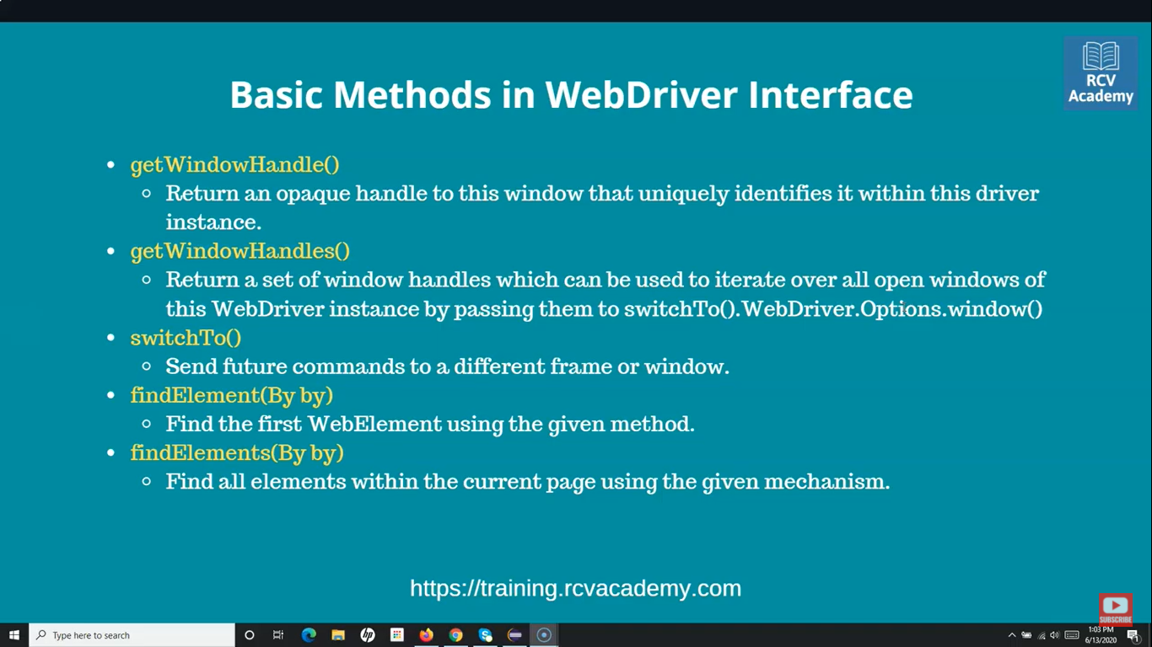
WebDriver Elements -Methods

Slide 36
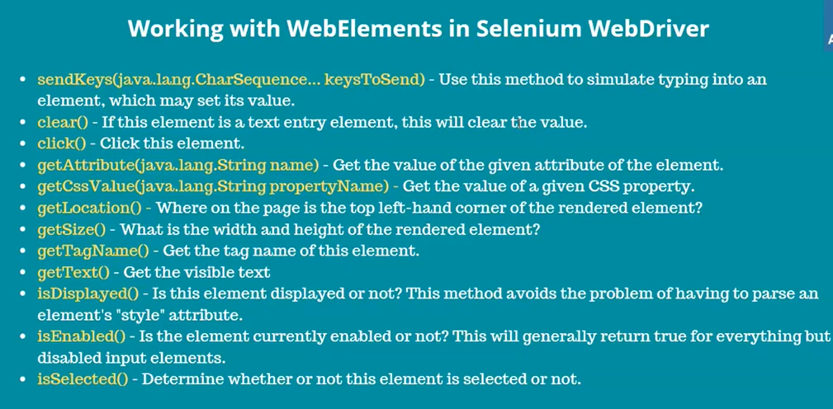
WebDriver Elements -Methods

Slide 37

What is Selenium Grid?
Selenium Grid is a part of the Selenium Suite that specializes in running multiple tests across different browsers, operating systems, and machines in parallel. It is achieved by routing the commands of remote browser instances where a server acts as a hub. A user needs to configure the remote server in order to execute the tests.
Selenium Grid uses a hub-node concept where you only run the test on a single machine called a hub, but the execution will be done by different machines called nodes.
When to Use Selenium Grid?
You should use Selenium Grid when you want to do either one or both of following:
Run your tests against different browsers, operating systems, and machines all at the same time. This will ensure that the application you are Testing is fully compatible with a wide range of browser-O.S combinations.
Save time in the execution of your test suites. If you set up Selenium Grid to run, say, 4 tests at a time, then you would be able to finish the whole suite around 4 times faster.

Slide 38
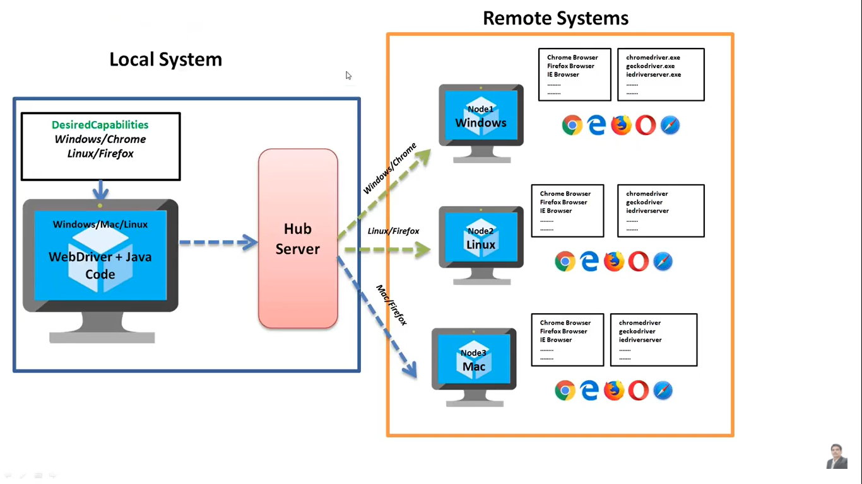
Selenium Grid

Slide 39
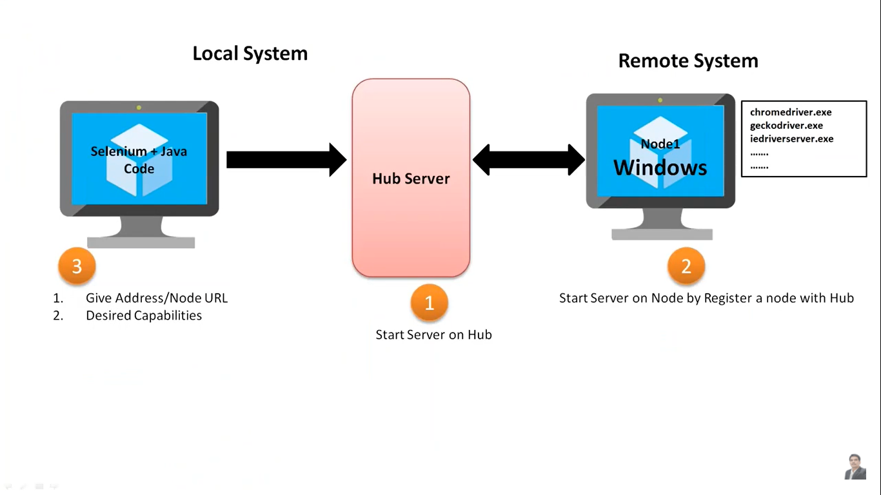
Selenium Grid

Slide 40
Selenium Grid Architecture
Selenium Grid has a Hub and Node Architecture.
The Hub
The hub is the central point where you load your tests into.
There should only be one hub in a grid.
The hub is launched only on a single machine, say, a computer whose O.S is Windows 7 and whose browser is IE.
The machine containing the hub is where the tests will be run, but you will see the browser being automated on the node.
The Nodes
Nodes are the Selenium instances that will execute the tests that you loaded on the hub.
There can be one or more nodes in a grid.
Nodes can be launched on multiple machines with different platforms and browsers.
The machines running the nodes need not be the same platform as that of the hub.
Selenium grid can be set up in two different ways; one through command line and the other through JSON config file.

Slide 41


